Slide 1
Machine Learning Clustering Algorithms-I [UNIT-I]

Slide 2

What is Machine Learning
In the real world, we are surrounded by humans who can learn everything from their experiences with their learning capability, and we have computers or machines that work on our instructions.
But can a machine also learn from experiences or past data like humans? So here comes the role of Machine Learning.

Slide 3
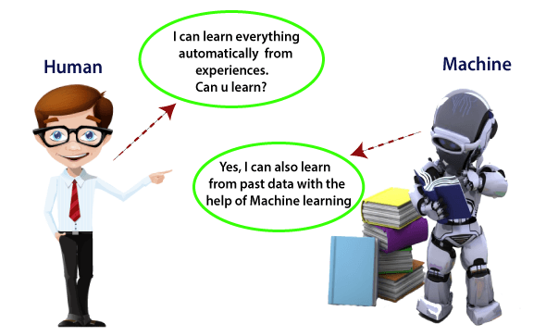

Slide 4
Machine Learning
A subset of artificial intelligence known as machine learning focuses primarily on creating algorithms that enable a computer to independently learn from data and previous experiences.
Machine learning algorithms create a mathematical model that, without being explicitly programmed, aids in making predictions or decisions with the assistance of sample historical data, or training data.

Slide 5
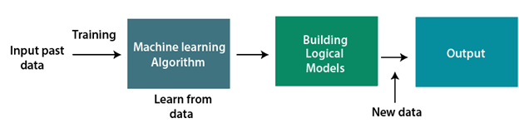
How does Machine Learning work
A machine learning system builds prediction models, learns from previous data, and predicts the output of new data whenever it receives it.
The amount of data helps to build a better model that accurately predicts the output, which in turn affects the accuracy of the predicted output.

Slide 6
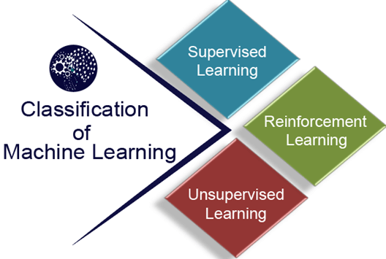
Classification of Machine Learning

Slide 7
1) Supervised Learning
In supervised learning, sample-labeled data are provided to the machine learning system for training, and the system then predicts the output based on the training data.
Supervised learning can be grouped further in two categories of algorithms:
Classification
Regression

Slide 8
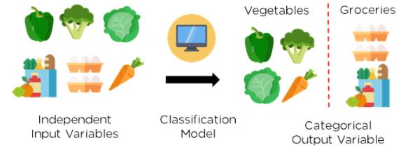
Classification
Classification is defined as the process of recognition, understanding, and grouping of objects and ideas into preset categories.
In short, classification is a form of “pattern recognition”
Fig: Classification of vegetables and groceries

Slide 9
Types of Classification
Decision Tree Classification: This type divides a dataset into segments based on particular feature variables. The divisions’ threshold values are typically the mean or mode of the feature variable if they happen to be numerical.
K-Nearest Neighbor: This Classification type identifies the K nearest neighbors to a given observation point. It then uses K points to evaluate the proportions of each type of target variable and predicts the target variable that has the highest ratio.
Logistic Regression: This classification type isn't complex so it can be easily adopted with minimal training. It predicts the probability of Y being associated with the X input variable.

Slide 10
Naïve Bayes: This classifier is one of the most effective yet simplest algorithms. It’s based on Bayes’ theorem, which describes how event probability is evaluated based on the previous knowledge of conditions that could be related to the event.
Random Forest Classification: Random forest processes many decision trees, each one predicting a value for target variable probability. You then arrive at the final output by averaging the probabilities.
Support Vector Machines: This algorithm employs support vector classifiers with an exciting change, making it ideal for evaluating non-linear decision boundaries. This process is possible by enlarging feature variable space by employing special functions known as kernels.

Slide 11
Regression
It is a supervised machine learning technique, used to predict the value of the dependent variable for new, unseen data. It models the relationship between the input features and the target variable, allowing for the estimation or prediction of numerical values. Therefore, regression algorithms help predict continuous variables such as house prices, market trends, weather patterns, and oil and gas prices.
Types of Regression:
Decision Tree Regression: The primary purpose of this regression is to divide the dataset into smaller subsets. These subsets are created to plot the value of any data point connecting to the problem statement.
Principal Components Regression: a statistical technique for regression analysis used to reduce a dataset's dimensionality by projecting it onto a lower-dimensional subspace.
This is done by finding a set of orthogonal (i.e., uncorrelated) linear combinations of the original variables, called principal components, that capture the most variance in the data.

Slide 12
Polynomial Regression: Polynomial regression is a type of regression analysis used in statistics and machine learning when the relationship between the independent variable (input) and the dependent variable (output) is not linear.
Random Forest Regression: Random Forest regression is heavily used in Machine Learning. It uses multiple decision trees to predict the output. Random data points are chosen from the given dataset and used to build a decision tree via this algorithm.
Simple Linear Regression: Simple Linear Regression is a type of Regression algorithm that models the relationship between a dependent variable and a single independent variable. The relationship shown by a Simple Linear Regression model is linear or a sloped straight line, hence it is called Simple Linear Regression.
Support Vector Regression: This regression type solves both linear and non-linear models. It uses non-linear kernel functions, like polynomials, to find an optimal solution for non-linear models.

Slide 13
2) Unsupervised Learning
Unsupervised learning is a learning method in which a machine learns without any supervision.
The training is provided to the machine with the set of data that has not been labeled, classified, or categorized, and the algorithm needs to act on that data without any supervision.
The goal of unsupervised learning is to restructure the input data into new features or a group of objects with similar patterns.

Slide 14
In unsupervised learning, we don't have a predetermined result. The machine tries to find useful insights from a huge amount of data.
It can be further classified into two categories of algorithms:
Clustering
Association

Slide 15
Clustering
Clustering or cluster analysis is a machine learning technique, which groups the unlabelled dataset.
It can be defined as "A way of grouping the data points into different clusters, consisting of similar data points.
The objects with the possible similarities remain in a group that has less or no similarities with another group.“
Note: It does it by finding some similar patterns in the unlabelled dataset such as shape, size, color, behavior, etc., and divides them as per the presence and absence of those similar patterns.

Slide 16
Example: Let's understand the clustering technique with the real-world example of Mall:
When we visit any shopping mall, we can observe that the things with similar usage are grouped.
Such as the t-shirts are grouped in one section, and the trousers are in other sections, similarly, at vegetable sections, apples, bananas, Mangoes, etc., are grouped in separate sections, so that we can easily find out the things.
The clustering technique also works in the same way. Other examples of clustering are grouping documents according to the topic.

Slide 17
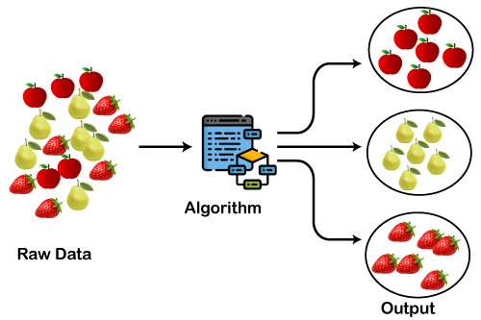
The below diagram explains the working of the clustering algorithm. We can see the different fruits are divided into several groups with similar properties.

Slide 18
Clustering Algorithms
K-Means algorithm: The k-means algorithm is one of the most popular clustering algorithms. It classifies the dataset by dividing the samples into different clusters of equal variances. The number of clusters must be specified in this algorithm. It is fast with fewer computations required, with the linear complexity of O(n).
Mean-shift algorithm: Mean-shift algorithm tries to find the dense areas in the smooth density of data points. It is an example of a centroid-based model, that works on updating the candidates for centroid to be the center of the points within a given region.
DBSCAN Algorithm: It stands for Density-Based Spatial Clustering of Applications with Noise. It is an example of a density-based model similar to the mean shift but with some remarkable advantages. In this algorithm, the areas of high density are separated by the areas of low density. Because of this, the clusters can be found in any arbitrary shape.

Slide 19
4. Expectation-Maximization Clustering using GMM: This algorithm can be used as an alternative for the k-means algorithm or for those cases where K-means can fail. In GMM, it is assumed that the data points are Gaussian distributed.
5. Agglomerative Hierarchical algorithm: The Agglomerative hierarchical algorithm performs the bottom-up hierarchical clustering. In this, each data point is treated as a single cluster at the outset and then successively merged. The cluster hierarchy can be represented as a tree structure.
6. Affinity Propagation: It is different from other clustering algorithms as it does not require specifying the number of clusters. In this, each data point sends a message between the pair of data points until convergence. It has O(N²T) time complexity, which is the main drawback of this algorithm.

Slide 20
Applications of Clustering
In Identification of Cancer Cells: The clustering algorithms are widely used for the identification of cancerous cells. It divides the cancerous and non-cancerous data sets into different groups.
In Search Engines: Search engines also work on the clustering technique. The search result appears based on the closest object to the search query. It does it by grouping similar data objects in one group that is far from the other dissimilar objects. The accurate result of a query depends on the quality of the clustering algorithm used.
Customer Segmentation: It is used in market research to segment the customers based on their choice and preferences.
In Biology: It is used in the biology stream to classify different species of plants and animals using the image recognition technique.

Slide 21
Association
Association rule learning is a type of unsupervised learning technique that checks for the dependency of one data item on another data item and maps accordingly so that it can be more profitable.
It tries to find some interesting relations or associations among the variables of dataset.
It is based on different rules to discover the interesting relations between variables in the database.

Slide 22
The association rule learning is one of the very important concepts of machine learning, and it is employed in Market Basket analysis, Web usage mining, continuous production, etc.
Here market basket analysis is a technique used by the various big retailers to discover the associations between items.
For example, if a customer buys bread, he most likely can also buy butter, eggs, or milk, so these products are stored within a shelf or mostly nearby. Consider the below diagram:

Slide 23
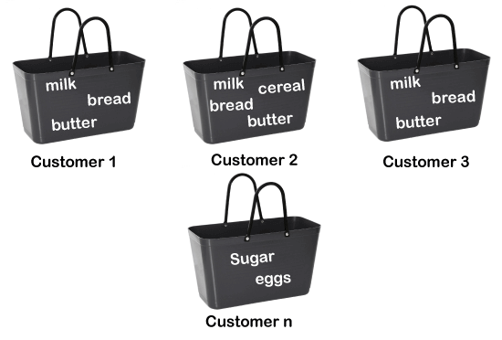

Slide 24
Applications of Association Rule Learning
Market Basket Analysis: It is one of the popular examples and applications of association rule mining. This technique is commonly used by big retailers to determine the association between items.
Medical Diagnosis: With the help of association rules, patients can be cured easily, as it helps in identifying the probability of illness for a particular disease.
Protein Sequence: The association rules help in determining the synthesis of artificial Proteins.

Slide 25
3) Reinforcement Learning
Reinforcement learning is a feedback-based learning method, in which a learning agent gets a reward for each right action and gets a penalty for each wrong action.
The agent learns automatically with these feedbacks and improves its performance.
In reinforcement learning, the agent interacts with the environment and explores it.
The goal of an agent is to get the most reward points, and hence, it improves its performance.
Note: The robotic dog, which automatically learns the movement of his arms, is an example of Reinforcement learning.

Slide 26
Unsupervised Learning
Unsupervised learning is a type of machine learning in which models are trained using unlabeled datasets and are allowed to act on that data without any supervision
Example: Suppose the unsupervised learning algorithm is given an input dataset containing images of different types of cats and dogs. The algorithm is never trained upon the given dataset, which means it does not have any idea about the features of the dataset.
The task of the unsupervised learning algorithm is to identify the image features on their own. An unsupervised learning algorithm will perform this task by clustering the image dataset into groups according to similarities between images..

Slide 27
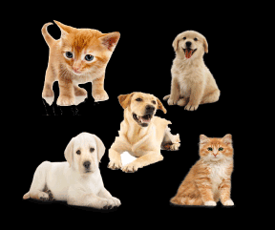
The task of the unsupervised learning algorithm is to identify the image features on their own.
An unsupervised learning algorithm will perform this task by clustering the image dataset into groups according to similarities between images..

Slide 28
Why use Unsupervised Learning?
Unsupervised learning helps to find useful insights from the data.
Unsupervised learning is much similar as a human learns to think by their own experiences, which makes it closer to the real AI.
Unsupervised learning works on unlabeled and uncategorized data which make unsupervised learning more important.
In real-world, we do not always have input data with the corresponding output so to solve such cases, we need unsupervised learning.

Slide 29
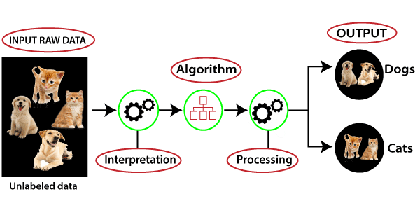
Working of Unsupervised Learning
Working of unsupervised learning can be understood by the below diagram:

Slide 30
Here, we have taken an unlabeled input data, which means it is not categorized and corresponding outputs are also not given. Now, this unlabeled input data is fed to the machine learning model in order to train it.
Firstly, it will interpret the raw data to find the hidden patterns from the data and then will apply suitable algorithms such as k-means clustering, Decision tree
Once it applies the suitable algorithm, the algorithm divides the data objects into groups according to the similarities and difference between the objects.

Slide 31
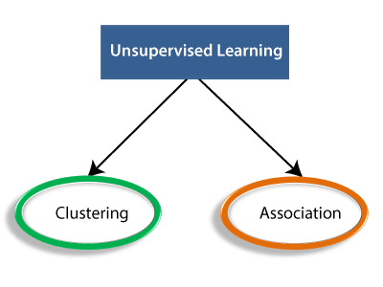
Types of Unsupervised Learning Algorithm:

Slide 32
Clustering: Clustering is a method of grouping the objects into clusters such that objects with most similarities remain in a group and have less or no similarities with the objects of another group.
Cluster analysis finds the commonalities between the data objects and categorizes them as per the presence and absence of those commonalities.
Association: An association rule is an unsupervised learning method which is used for finding the relationships between variables in a large database.
It determines the set of items that occur together in the dataset. Association rule makes marketing strategy more effective.
Such as people who buy X items (suppose bread) also tend to purchase Y (Butter/Jam) items. A typical example of an Association rule is Market Basket Analysis.

Slide 33
Unsupervised Learning algorithms:
K-means clustering
KNN (k-nearest neighbors)
Hierarchal clustering
Neural Networks
Principle Component Analysis
Apriori algorithm

Slide 34
Advantages of Unsupervised Learning
Unsupervised learning is used for more complex tasks as compared to supervised learning because, in unsupervised learning, we don't have labeled input data.
Unsupervised learning is preferable as it is easy to get unlabeled data in comparison to labeled data.

Slide 35
Disadvantages of Unsupervised Learning
Unsupervised learning is intrinsically more difficult than supervised learning as it does not have corresponding output.
The result of the unsupervised learning algorithm might be less accurate as input data is not labeled, and algorithms do not know the exact output in advance.

Slide 36
Supervised Learning | Unsupervised Learning
Supervised learning algorithms are trained using labeled data. | Unsupervised learning algorithms are trained using unlabeled data.
Supervised learning model takes direct feedback to check if it is predicting correct output or not. | Unsupervised learning model does not take any feedback.
Supervised learning model predicts the output. | Unsupervised learning model finds the hidden patterns in data.
In supervised learning, input data is provided to the model along with the output. | In unsupervised learning, only input data is provided to the model.
The goal of supervised learning is to train the model so that it can predict the output when it is given new data. | The goal of unsupervised learning is to find the hidden patterns and useful insights from the unknown dataset.
Supervised learning needs supervision to train the model. | Unsupervised learning does not need any supervision to train the model.
Supervised learning can be categorized in Classification and Regression problems. | Unsupervised Learning can be classified in Clustering and Associations problems.

Slide 37
Clustering Techniques
Clustering has been studied extensively for more than 40 years and across many disciplines due to its broad applications.
k-Means algorithm [1957, 1967]
k-Medoids algorithm
k-Modes [1998]
Fuzzy c-means algorithm [1999]
Partitioning methods
Divisive
Hierarchical methods
Agglomerative methods
Clustering Techniques
Density-based methods
STING [1997]
DBSCAN [1996]
CLIQUE [1998]

Slide 38
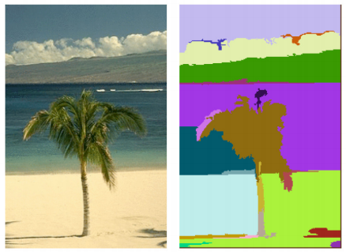
Clustering: Some Examples
Document/Image/Webpage Clustering
Image Segmentation (clustering pixels)
Clustering web search results
Clustering (people) nodes in (social) networks/graphs
.. and many more.
Picture courtesy: http://people.cs.uchicago.edu/∼pff/segment/

Slide 39
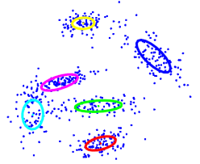
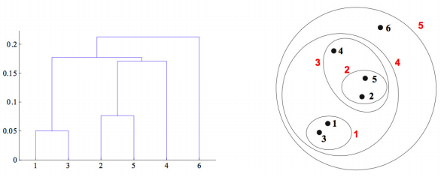
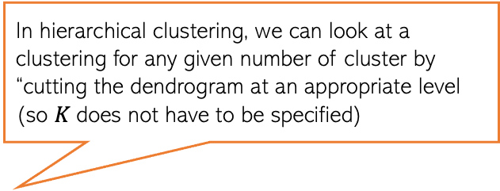
Types of Clustering
Flat or Partitional clustering
Partitions are independent of each other
Hierarchical clustering
Partitions can be visualized using a tree structure (a dendrogram)
In hierarchical clustering, we can look at a clustering for any given number of cluster by “cutting the dendrogram at an appropriate level (so $K$does not have to be specified)
Hierarchical clustering gives us a clustering at multiple levels of granularity

Slide 40
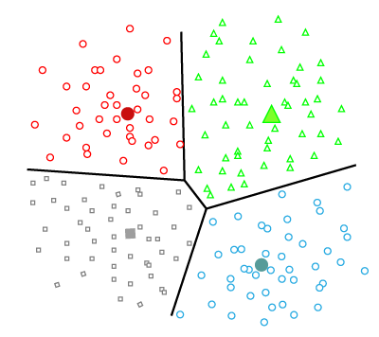
Partitioning Clustering
It is a type of clustering that divides the data into non-hierarchical groups. It is also known as the centroid-based method.
In this type, the dataset is divided into a set of k groups, where K is used to define the number of pre-defined groups. The cluster center is created in such a way that the distance between the data points of one cluster is minimum as compared to another cluster centroid.

Slide 41
Hierarchical Clustering:
Hierarchical clustering can be used as an alternative for the partitioned clustering as there is no requirement of pre-specifying the number of clusters to be created.
In this technique, the dataset is divided into clusters to create a tree-like structure, which is also called a dendrogram.
The observations or any number of clusters can be selected by cutting the tree at the correct level.
The most common example of this method is the Agglomerative Hierarchical algorithm

Slide 42
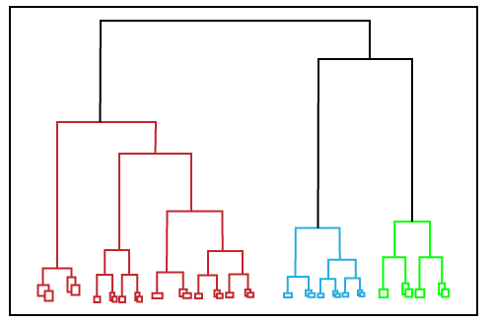

Slide 43
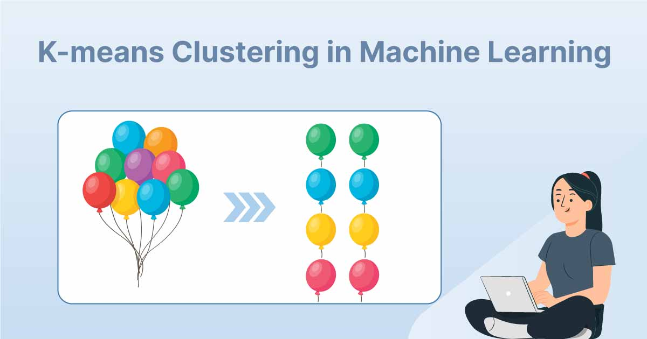

Slide 44
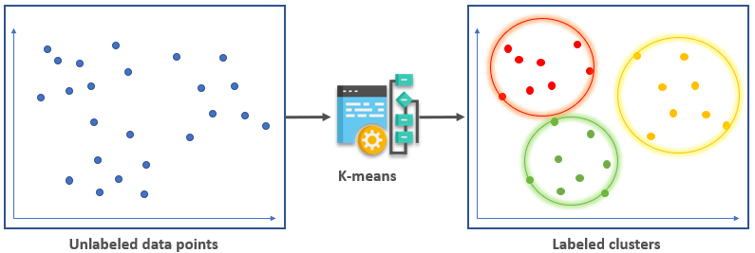
K-means is a clustering algorithm designed to divide data points into distinct clusters depending on the similarities between the observations. Data points that share relevant characteristics are grouped together, implying that data points in different clusters would be dissimilar.

Slide 45
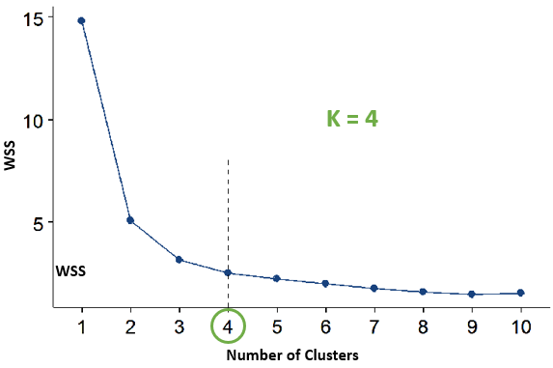
How to choose the value of K?
The Elbow Method
The method consists of plotting the total WSS(within the sum of squares ) as a function of the various number of clusters. Then, pick the ‘elbow’ of the curve as the appropriate number of clusters. See the example below.

Slide 46
Implementing K-means Clustering
Start by visualizing some data points:
import matplotlib.pyplot as plt x = [4, 5, 10, 4, 3, 11, 14 , 6, 10, 12] y = [21, 19, 24, 17, 16, 25, 24, 22, 21, 21] plt.scatter(x, y) plt.show()

Slide 47
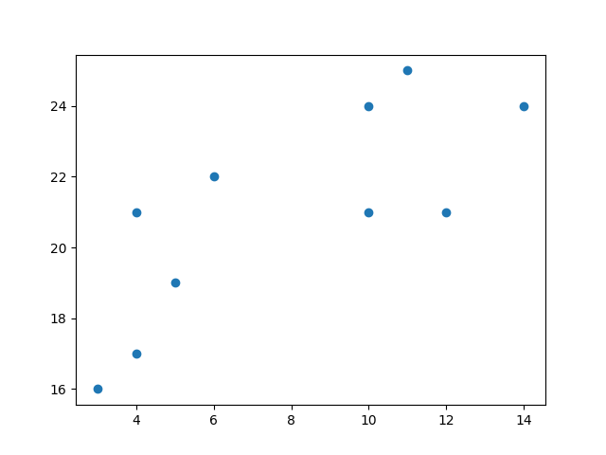
Result

Slide 48
Now we utilize the elbow method to visualize the intertia for different values of K:
from sklearn.cluster import KMeans data = list(zip(x, y)) inertias = [] for i in range(1,11): kmeans = KMeans(n_clusters=i) kmeans.fit(data) inertias.append(kmeans.inertia_) plt.plot(range(1,11), inertias, marker='o') plt.title('Elbow method') plt.xlabel('Number of clusters') plt.ylabel('Inertia') plt.show()

Slide 50
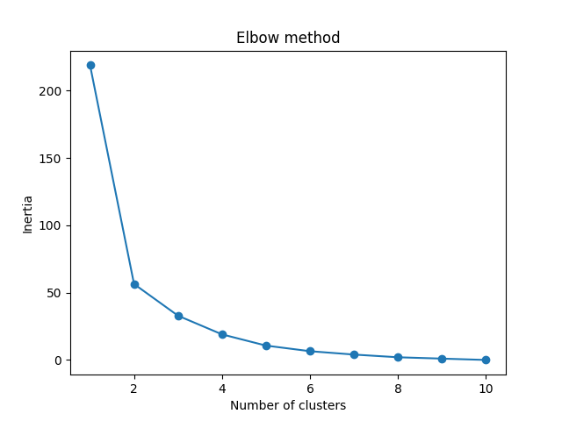
Result

Slide 51
The elbow method shows that 2 is a good value for K, so we retrain and visualize the result:
kmeans = KMeans(n_clusters=2) kmeans.fit(data) plt.scatter(x, y, c=kmeans.labels_) plt.show()

Slide 52
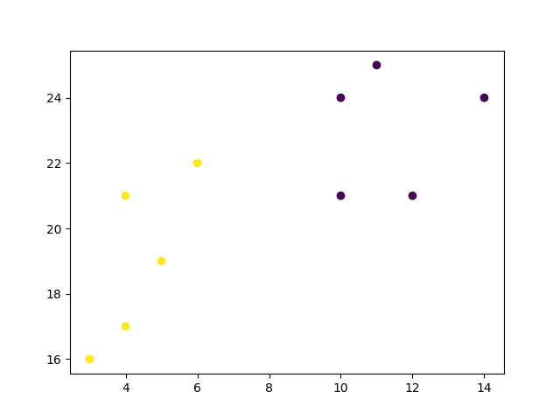
Result

Slide 53
Import the modules you need.
import matplotlib.pyplot as plt from sklearn.cluster import Kmeans
Create arrays that resemble two variables in a dataset. Note that while we only use two variables here, this method will work with any number of variables:
x = [4, 5, 10, 4, 3, 11, 14 , 6, 10, 12] y = [21, 19, 24, 17, 16, 25, 24, 22, 21, 21]

Slide 54
Turn the data into a set of points:
data = list(zip(x, y)) print(data)
Result:
[(4, 21), (5, 19), (10, 24), (4, 17), (3, 16), (11, 25), (14, 24), (6, 22), (10, 21), (12, 21)]
In order to find the best value for K, we need to run K-means across our data for a range of possible values. We only have 10 data points, so the maximum number of clusters is 10. So for each value K in range(1,11), we train a K-means model and plot the intertia at that number of clusters:

Slide 55
inertias = [] for i in range(1,11): kmeans = KMeans(n_clusters=i) kmeans.fit(data) inertias.append(kmeans.inertia_) plt.plot(range(1,11), inertias, marker='o') plt.title('Elbow method') plt.xlabel('Number of clusters') plt.ylabel('Inertia') plt.show()

Slide 56
Result:

Slide 57
We can see that the "elbow" on the graph above (where the interia becomes more linear) is at K=2. We can then fit our K-means algorithm one more time and plot the different clusters assigned to the data:
kmeans = KMeans(n_clusters=2) kmeans.fit(data) plt.scatter(x, y, c=kmeans.labels_) plt.show()

Slide 58
Result:

Slide 59
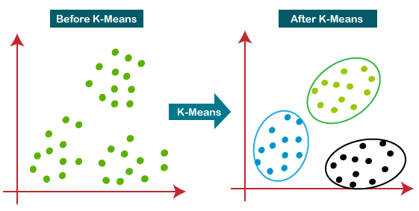
The below diagram explains the working of the K-means Clustering Algorithm:

Slide 60
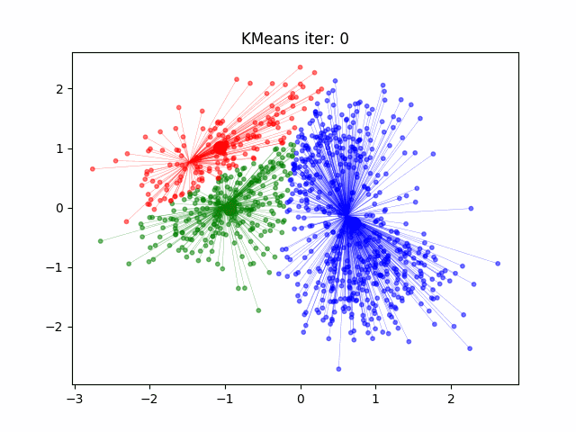
K-means: An Illustration

Slide 61
Initializing K-means.
Initializing K-means is the initial step of the K-means clustering algorithm, which is an unsupervised machine learning technique used for partitioning data points into K clusters.
The goal of K-means is to minimize the sum of squared distances between data points and their corresponding cluster centers, often referred to as centroids.

Slide 62
General process for initializing K-means
Choose the number of clusters (K): Decide the number of clusters you want to partition your data into. This is a user-specified parameter and requires domain knowledge or experimentation to determine the optimal value.
Select initial centroids: Randomly select K data points from your dataset as the initial centroids. These data points will serve as the starting positions for the cluster centers.
Assign data points to clusters: Calculate the distance between each data point and all the centroids. Assign each data point to the cluster with the nearest centroid. This step forms the initial clustering.

Slide 63
Cont.
4. Update centroids: Calculate the mean (center) of the data points within each cluster and move the centroids to these new positions.
5. Repeat steps 3 and 4: Continue steps 3 and 4 iteratively until convergence or until a specified number of iterations is reached. Convergence happens when the cluster assignments stop changing significantly or when the centroids stop moving substantially.
6. Final clustering: Once convergence is reached, the algorithm stops, and you have your final clustering result.

Slide 64
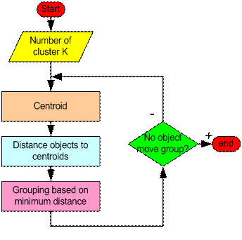
What have we learned so far…

Slide 65
Step 1: Begin with a decision on the value of k = number of clusters .
Step 2: Put any initial partition that classifies the data into k clusters. You may assign the training samples randomly, or systematically as the following:
Take the first k training sample as single-element clusters
Assign each of the remaining (N-k) training sample to the cluster with the nearest centroid. After each assignment, recompute the centroid of the gaining cluster.

Slide 66
Step 3: Take each sample in sequence and compute its distance from the centroid of each of the clusters. If a sample is not currently in the cluster with the closest centroid, switch this sample to that cluster and update the centroid of the cluster gaining the new sample and the cluster losing the sample.
Step 4: Repeat step 3 until convergence is achieved, that is until a pass through the training sample causes no new assignments.

Slide 67
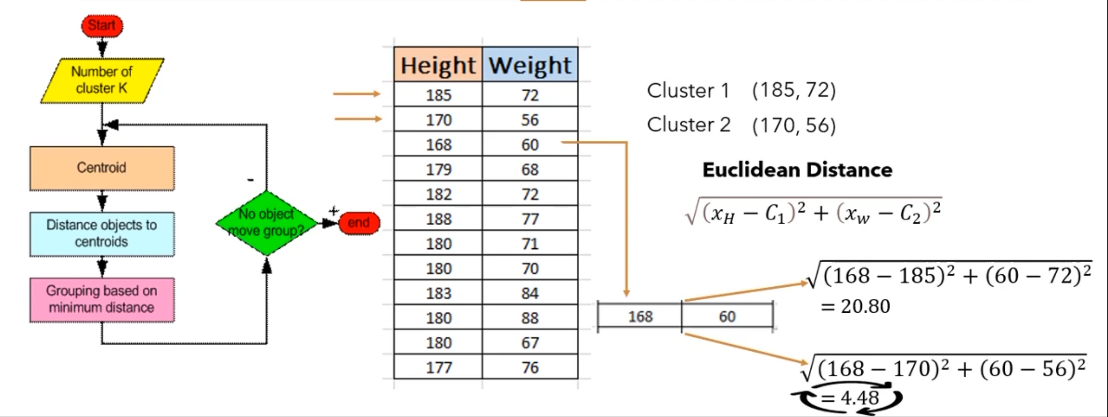

Slide 68
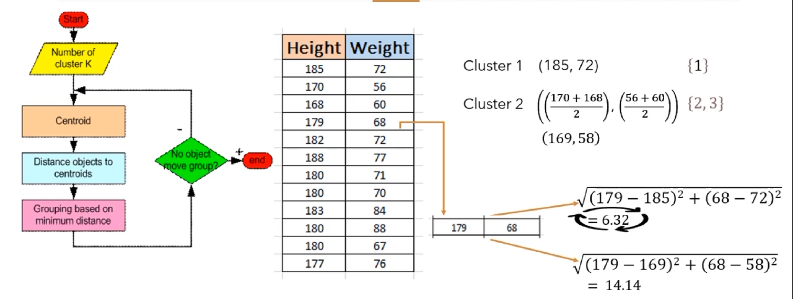

Slide 69
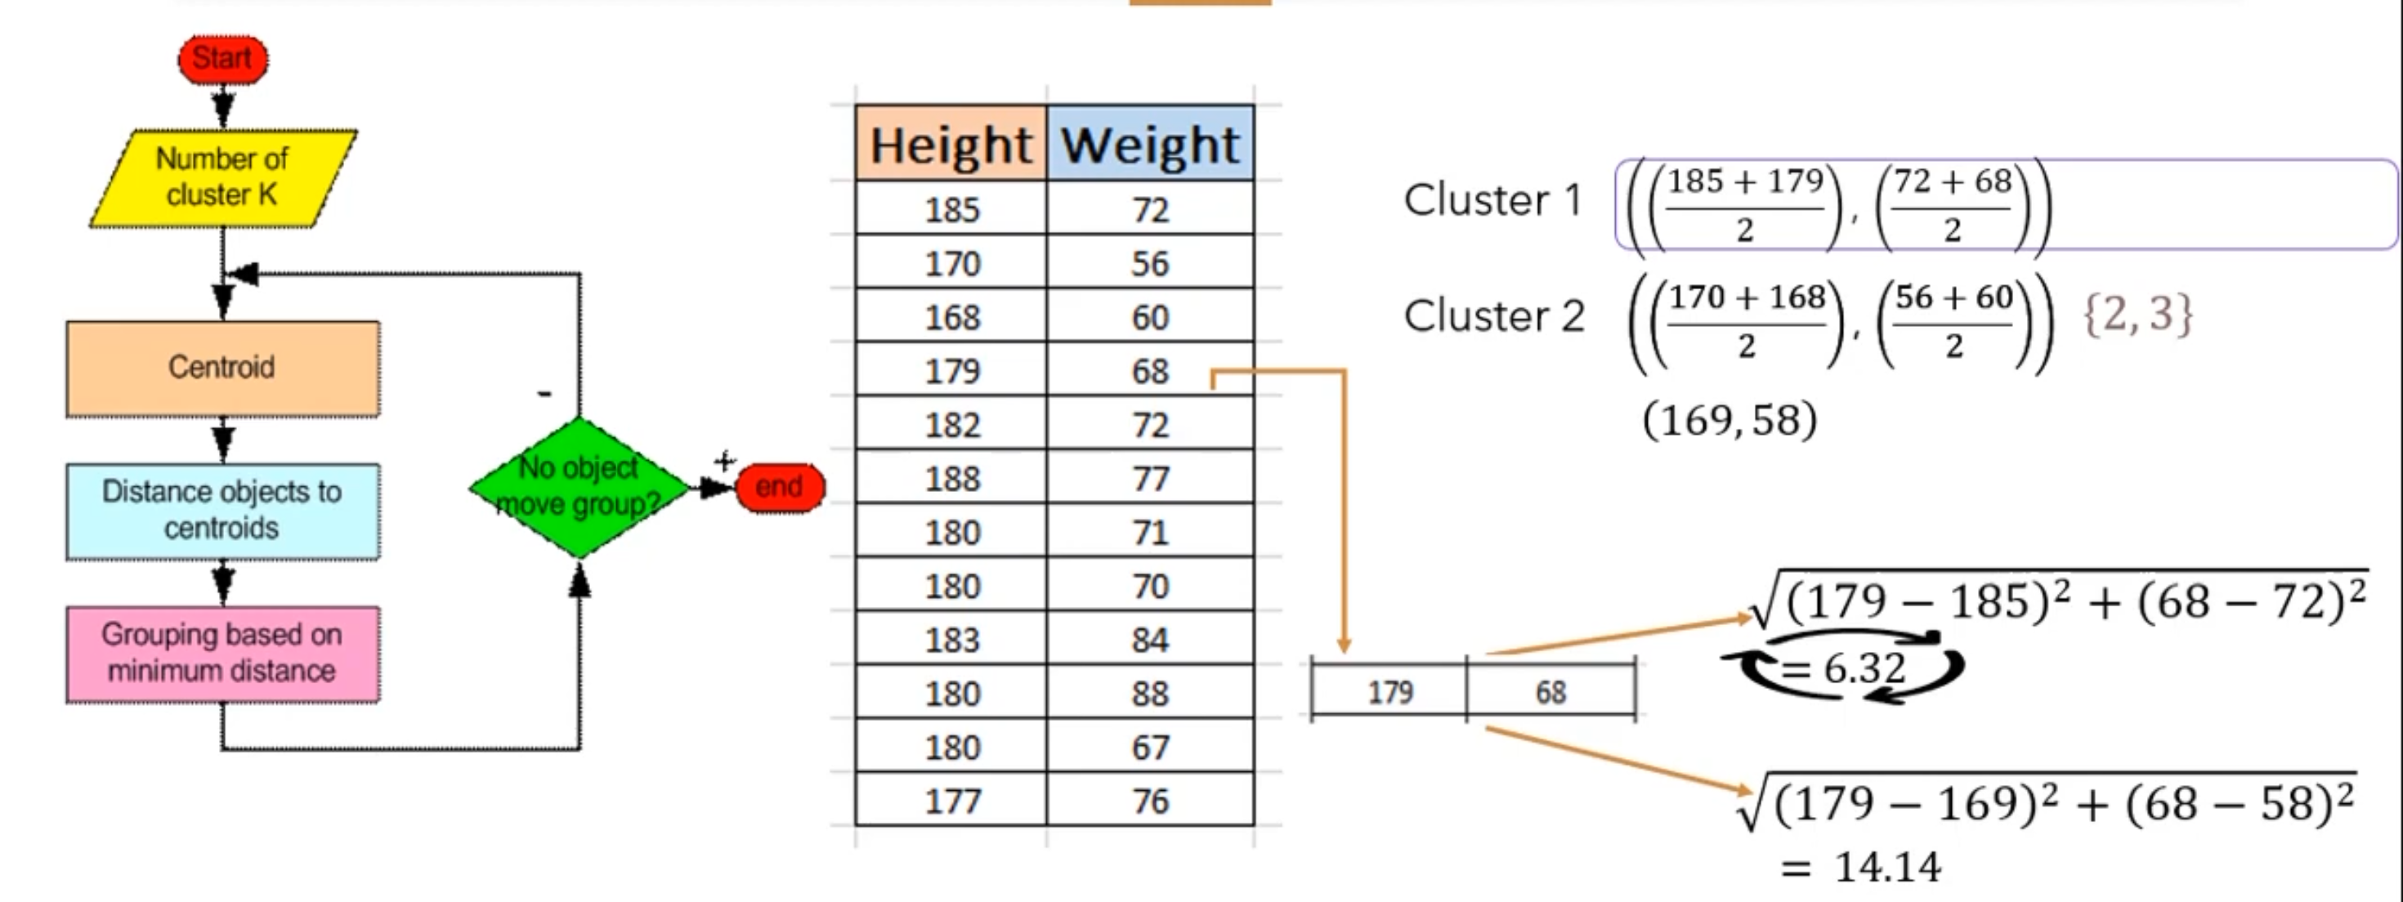

Slide 70
Uses of Clustering
Market Segmentation – Businesses use clustering to group their customers and use targeted advertisements to attract more audience.
Market Basket Analysis – Shop owners analyze their sales and figure out which items are majorly bought together by the customers. For example, In USA, according to a study diapers and beers were usually bought together by fathers.
Social Network Analysis – Social media sites use your data to understand your browsing behaviour and provide you with targeted friend recommendations or content recommendations.
Medical Imaging – Doctors use Clustering to find out diseased areas in diagnostic images like X-rays.
Anomaly Detection – To find outliers in a stream of real-time dataset or forecasting fraudulent transactions we can use clustering to identify them.

Slide 71
Hard Clustering
Definition: In hard clustering, each data point is assigned to one and only one cluster. The assignment is definitive, meaning a data point belongs to a single cluster with certainty.
Algorithms: Common hard clustering algorithms include K-Means, Hierarchical Clustering (Agglomerative and Divisive), and DBSCAN.
Limitations:
Not Flexible: It doesn’t handle overlapping clusters well.
Sensitivity to Outliers: Outliers can significantly affect the clustering results.

Slide 72
Soft Clustering
Definition: In soft clustering, data points can belong to multiple clusters with varying degrees of membership. This approach provides a probability or degree of membership for each cluster.
Algorithms: Fuzzy C-Means (FCM) is a well-known soft clustering algorithm. Other probabilistic models include Gaussian Mixture Models (GMM).
Applications: Suitable for scenarios where clusters may overlap or where data points are not distinctly separable, such as in image segmentation or gene expression data.

Slide 73
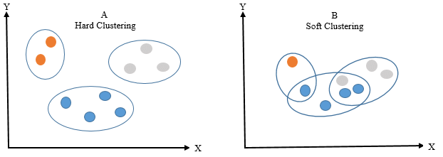
Hard vs Soft Clustering

Slide 74
Hard Clustering
Also known as Exclusive Clustering or Crisp Clustering.
Each data point is assigned to exactly one cluster.
Results in non-overlapping clusters with clear boundaries.
E.g., K-means

Slide 75
Advantages
Simplicity and Ease of Implementation: Hard clustering algorithms are straightforward to understand and implement.
Computational Efficiency: Ideal for handling large datasets efficiently.
Clear Cluster Membership: Each data point unambiguously belongs to a single cluster.
Disadvantages
Sensitive to Initial Placement: Results can vary depending on the initial cluster centroids.
Limited Handling of Overlapping Data: May struggle with complex data structures that have overlapping clusters.
Impact of Outliers: Outliers can significantly affect cluster assignments.

Slide 76
Soft Clustering
Also known as Fuzzy Clustering.
Allows data points to belong to multiple clusters with varying membership degrees.
Provides more flexibility and captures uncertainty in cluster assignments.
E.g., Fuzzy C-means (FCM)

Slide 77
Advantages
Handling Overlapping Data: Well-suited for datasets with complex or overlapping structures.
Robustness to outliers: The ability of a clustering algorithm to minimize the influence of outliers on the assignment of data points to clusters. (probability distribution over clusters instead of a hard assignment to a single cluster)
Disadvantages
Computational Complexity: Soft clustering methods can be more computationally expensive than their hard clustering counterparts.
Determining the Number of Clusters: Requires the pre-specification of the number of clusters or fuzziness coefficient.
Interpretability Challenges: Fuzzy memberships might be more challenging to interpret.

Slide 78
How to Find the Optimal Number of Clusters
The elbow method is a popular technique used to determine the optimal number of clusters (k) in a clustering algorithm, such as K-means.
It involves plotting the cost (inertia) of clustering as a function of the number of clusters and looking for the "elbow point" in the plot.
The elbow point is the value of k at which the inertia starts to level off or decrease at a slower rate.
This point indicates that adding more clusters does not significantly improve the clustering quality and suggests the appropriate number of clusters for the data.

Slide 79
Cont.
The elbow method helps us find the optimal number of clusters for our data.
It involves analyzing the inertia (within-cluster sum of squares) as a function of the number of clusters.

Slide 80
Elbow Method
Elbow Method is a technique that we use to determine the number of centroids(k) to use in a k-means clustering algorithm.
In this method to determine the k-value we continuously iterate for k=1 to k=n (Here n is the hyperparameter that we choose as per our requirement).
For every value of k, we calculate the within-cluster sum of squares (WCSS) value.
Note:
WCSS - It is defined as the sum of square distances between the centroids and each point.

Slide 81
Implementation of the Elbow Method Usking Sklearn in Python
We will see how to implement the elbow method in 4 steps.
At first, we will create random dataset points, then we will apply k-means on this dataset and calculate wcss value for k between 1 to 4.
Step 1: Importing the required libraries
from sklearn.cluster import KMeans
from sklearn import metrics
from scipy.spatial.distance import cdist
import numpy as np
import matplotlib.pyplot as plt

Slide 82
Step 2: Creating and Visualizing the data
We will create a random array and visualize its distribution
# Creating the data
x1 = np.array([3, 1, 1, 2, 1, 6, 6, 6, 5, 6,\
7, 8, 9, 8, 9, 9, 8, 4, 4, 5, 4])
x2 = np.array([5, 4, 5, 6, 5, 8, 6, 7, 6, 7, \
1, 2, 1, 2, 3, 2, 3, 9, 10, 9, 10])
X = np.array(list(zip(x1, x2))).reshape(len(x1), 2)
# Visualizing the data
plt.plot()
plt.xlim([0, 10])
plt.ylim([0, 10])
plt.title('Dataset')
plt.scatter(x1, x2)
plt.show()

Slide 83
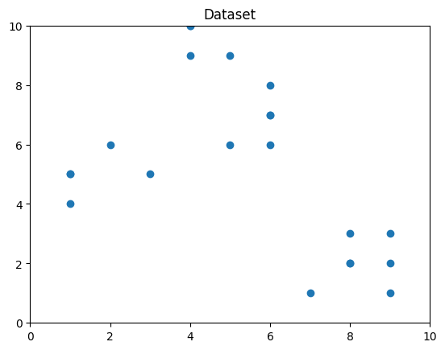
Output:
From the above visualization, we can see that the optimal number of clusters should be around 3. But visualizing the data alone cannot always give the right answer.

Slide 84
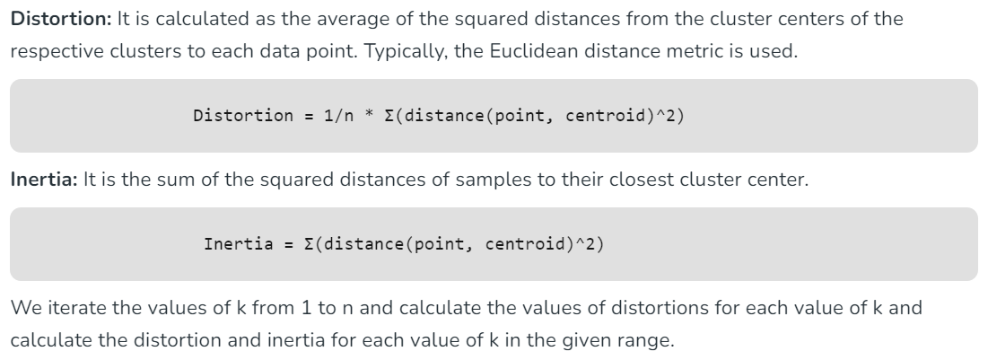
Note: Distortion is the alteration of the original shape

Slide 85
Step 3: Building the clustering model and calculating the values of the Distortion and Inertia:
distortions = []
inertias = []
mapping1 = {}
mapping2 = {}
K = range(1, 10)
for k in K:
# Building and fitting the model
kmeanModel = KMeans(n_clusters=k).fit(X)
kmeanModel.fit(X)
distortions.append(sum(np.min(cdist(X, kmeanModel.cluster_centers_,
'euclidean'), axis=1)) /X.shape[0])
inertias.append(kmeanModel.inertia_)
mapping1[k] = sum(np.min(cdist(X, kmeanModel.cluster_centers_,
'euclidean'), axis=1)) / X.shape[0]
mapping2[k] = kmeanModel.inertia_

Slide 86
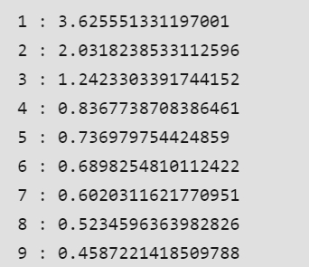
for key, val in mapping1.items():
print(f'{key} : {val}’)
Output:
Step 4: Tabulating and Visualizing the Results a) Using the different values of Distortion:

Slide 87
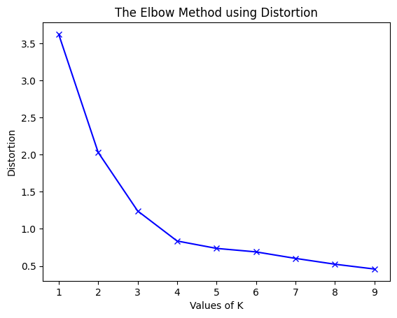
Next we will plot the graph of k versus WCSS
plt.plot(K, distortions, 'bx-')
plt.xlabel('Values of K')
plt.ylabel('Distortion')
plt.title('The Elbow Method using Distortion')
plt.show()
Output:

Slide 88
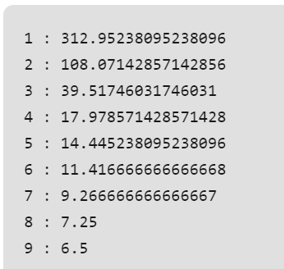
b) Using the different values of Inertia:
for key, val in mapping2.items():
print(f'{key} : {val}’)
Output:

Slide 89
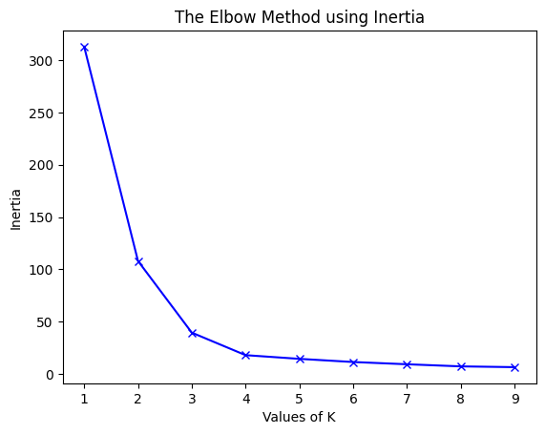
plt.plot(K, inertias, 'bx-')
plt.xlabel('Values of K')
plt.ylabel('Inertia')
plt.title('The Elbow Method using Inertia')
plt.show()
Output:

Slide 90
Elbow Method: Step by Step
Choose a range of k values to consider (e.g., 1 to 10).
For each k value, run the K-means algorithm with k clusters on the data.
Calculate the inertia (sum of squared distances within clusters) for each k.
Plot the inertia values against the corresponding k values.

Slide 91
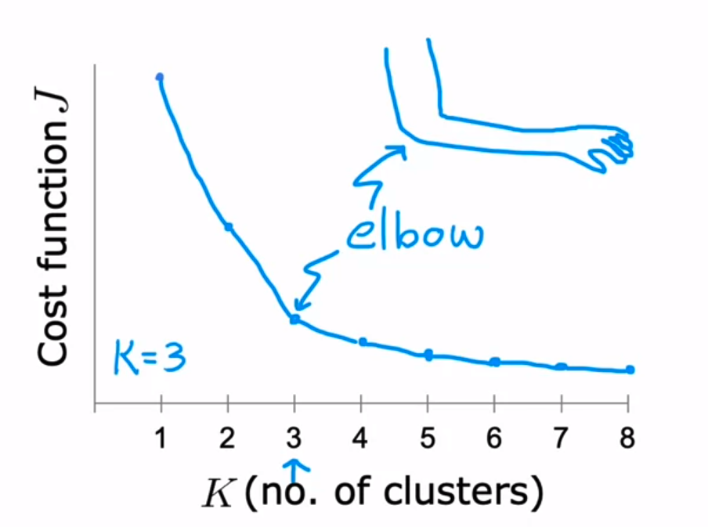
Cont.

Slide 92
Identifying the Elbow Point
The elbow point is the optimal k value.
It is the point where inertia starts to level off or decreases at a slower rate.
Adding more clusters beyond this point may not significantly improve clustering quality.

Slide 93
Limitations of the Elbow Method
The elbow method may not always yield a clear-cut elbow point, especially for complex datasets.
It is subjective, and the optimal k value may vary based on interpretation.

Slide 94
Weaknesses of K-Mean Clustering
When the numbers of data are not so many, initial grouping will determine the cluster significantly.
The number of cluster, K, must be determined before hand. Its disadvantage is that it does not yield the same result with each run, since the resulting clusters depend on the initial random assignments.
We never know the real cluster, using the same data, because if it is inputted in a different order it may produce different cluster if the number of data is few.
It is sensitive to initial condition. Different initial condition may produce different result of cluster. The algorithm may be trapped in the local optimum.

Slide 95
Applications of K-Mean Clustering
It is relatively efficient and fast. It computes result at O(tkn), where n is number of objects or points, k is number of clusters and t is number of iterations.
k-means clustering can be applied to machine learning or data mining
Used on acoustic data in speech understanding to convert waveforms into one of k categories (known as Vector Quantization or Image Segmentation).
Also used for choosing color palettes on old fashioned graphical display devices and Image Quantization.

Slide 96
CONCLUSION
K-means algorithm is useful for undirected knowledge discovery and is relatively simple.
K-means has found wide spread usage in lot of fields, ranging from unsupervised learning of neural network, Pattern recognitions, Classification analysis, Artificial intelligence, image processing, machine vision, and many others.

Slide 97
Drawback of standard K-means algorithm: One disadvantage of the K-means algorithm is that it is sensitive to the initialization of the centroids or the mean points. So, if a centroid is initialized to be a “far-off” point, it might just end up with no points associated with it, and at the same time, more than one cluster might end up linked with a single centroid. Similarly, more than one centroid might be initialized into the same cluster resulting in poor clustering. To overcome the above-mentioned drawback we use K-means++.

Slide 98
K Means++
This algorithm ensures a smarter initialization of the centroids and improves the quality of the clustering.
Apart from initialization, the rest of the algorithm is the same as the standard K-means algorithm.
That is K-means++ is the standard K-means algorithm coupled with a smarter initialization of the centroids.

Slide 99
Kmeans++
KMeans++ is an improved initialization technique for the KMeans clustering algorithm.
The primary goal of KMeans++ is to provide a better initial set of cluster centroids, which in turn leads to faster convergence and higher-quality clustering results compared to the standard random initialization used in traditional KMeans.
(Problem with kmeans)
Different initialization will result in different clusters.

Slide 100
Kmeans++ Algorithm
Select the First Centroid:
Choose one data point randomly from the dataset as the first centroid.
Calculate Distances:
For each data point that has not been selected as a centroid, calculate the distance (usually using Euclidean distance) from that point to the nearest centroid that has already been chosen.
Select Subsequent Centroids:
The next centroid is chosen from the remaining data points with a probability proportional to the square of the distance from the nearest existing centroid. This ensures that points that are far from existing centroids are more likely to be selected as new centroids.
Repeat Step 2 and 3:
Repeat the distance calculation and centroid selection process until the desired number of centroids is reached.

Slide 101
Kmeans++ Numerical
Let's say we have a small dataset of two-dimensional points:
Data Points:
(2, 3), (3, 2), (8, 8), (10, 9), (11, 10)
We want to perform KMeans clustering with K=2 clusters.

Slide 103
Step 1
Select First Centroid:
Choose a random data point as the first centroid. Let's say we choose (2, 3).

Slide 104
Step 2
Calculate Distances:
Calculate the squared distances from each data point to the chosen centroid (2, 3):
Distance from (3, 2) = (3 - 2)^2 + (2 - 3)^2 = 2
Distance from (8, 8) = (8 - 2)^2 + (8 - 3)^2 = 61
Distance from (10, 9) = (10 - 2)^2 + (9 - 3)^2 = 100
Distance from (11, 10) = (11 - 2)^2 + (10 - 3)^2 = 130

Slide 105
Step 3
Select Subsequent Centroid:
The next centroid is selected based on the calculated squared distances. The probability of selecting a point as the next centroid is proportional to its squared distance from the nearest existing centroid.
Calculate the probabilities for each point:
Probability for (3, 2) = 2 / (2 + 61 + 100 + 130) ≈ 0.0068
Probability for (8, 8) = 61 / (2 + 61 + 100 + 130) ≈ 0.2081
Probability for (10, 9) = 100 / (2 + 61 + 100 + 130) ≈ 0.3412
Probability for (11, 10) = 130 / (2 + 61 + 100 + 130) ≈ 0.4436
Choose the next centroid based on these probabilities. For simplicity, let's assume (11, 10) is selected as the second centroid.

Slide 106
Step 4
Repeat Steps 2 and 3:
Recalculate distances from each data point to the two centroids (2, 3) and (11, 10) and calculate new probabilities.
Choose the third centroid based on the probabilities.

Slide 107
KMedians
"KMedians," another clustering algorithm that is similar to KMeans but uses medians instead of means to calculate the cluster centroids.
Medians is particularly useful when dealing with data that might have outliers or when you want to create clusters based on the median values of the data points rather than the mean values.

Slide 108
Kmedians Algorithm
Initialization:
Just like KMeans, KMedians also requires an initial set of cluster centroids. These centroids can be randomly chosen data points or selected using other methods.
Assignment Step:
Each data point is assigned to the nearest centroid based on the Manhattan distance (also known as L1 distance) rather than Euclidean distance, which is used in KMeans. The Manhattan distance is the sum of the absolute differences between the coordinates of the data point and the centroid.
Update Step:
After the assignment step, the medians of the data points in each cluster are calculated. The median value of a set of numbers is the middle value when they are sorted in order. It's a more robust measure than the mean because it's less affected by outliers.
Iteration:
The assignment and update steps are repeated iteratively until convergence. In each iteration, data points are reassigned to the nearest centroids based on Manhattan distance, and then the centroids are updated using the medians of the data points in each cluster.

Slide 109
Advantages of KMedians
The main advantage of KMedians over KMeans is its robustness to outliers.
Outliers can significantly influence the mean-based centroids in KMeans, whereas medians are less affected by extreme values.
However, KMedians can also be computationally more expensive than KMeans since calculating medians involves sorting data points.

Slide 110
Kmedians Numerical
Let's consider a small dataset of one-dimensional points:
Data Points: 2, 3, 7, 8, 10, 12, 15, 20, 25
Assuming we want to perform KMedians clustering with K=2 clusters.

Slide 111
Step 1
Initialization:
Choose two initial medians randomly or using some other initialization method. Let's say we start with medians at 7 and 20.

Slide 112
Step 2
Assignment Step:
For each data point, calculate the Manhattan distance (L1 distance) from each of the cluster medians. Assign each data point to the nearest median's cluster.
Data
Point |Median 7|Median 20| Assigned Cluster
-----------------------------------------------------------------
2 | 5 | 18 | 1
3 | 4 | 17 | 1
7 | 0 | 13 | 1
8 | 1 | 12 | 1
10 | 3 | 10 | 1
12 | 5 | 8 | 1
15 | 8 | 5 | 2
20 | 13 | 0 | 2
25 | 18 | 5 | 2

Slide 113
Step 3
Update Step (Calculation of Medians):
For each cluster, calculate the median of the data points in that cluster. The median is the middle value when the data points are sorted.
Repeat the assignment and update steps until convergence. In each iteration, reassign data points to the nearest medians and update the medians based on the median of the data points in each cluster.
Cluster 1 Median: 7.5
Cluster 2 Median: 20

Slide 114
K-Medoid
K-Medoids is particularly useful when dealing with non-numerical data or when you want clusters that are centered around actual data points.
"K-Medoids," is a clustering algorithm similar to KMeans but uses actual data points as cluster representatives (medoids) instead of the mean or centroid.
Medoids are representative objects of a data set or a cluster within a data set whose sum of dissimilarities to all the objects in the cluster is minimal.
Medoids are similar in concept to means or centroids, but medoids are always restricted to be members of the data set.
Medoids are most commonly used on data when a mean or centroid cannot be defined, such as graphs.

Slide 115
K-Medoid
First, we select K random data points from the dataset and use them as medoids.
Now, we will calculate the distance of each data point from the medoids. You can use any of the Euclidean, Manhattan distance, or squared Euclidean distance as the distance measure.
Once we find the distance of each data point from the medoids, we will assign the data points to the clusters associated with each medoid. The data points are assigned to the medoids at the closest distance.
After determining the clusters, we will calculate the sum of the distance of all the non-medoid data points to the medoid of each cluster. Let the cost be C_{i}.

Slide 117
5. Now, we will select a random data point D_{j} from the dataset and swap it with a medoid M_{i}. Here, D_{j} becomes a temporary medoid. After swapping, we will calculate the distance of all the non-medoid data points to the current medoid of each cluster. Let this cost be C_{j}.
6. If C_{i}>C_{j}, the current medoids with D_{j} as one of the medoids are made permanent medoids. Otherwise, we undo the swap, and M_{i} is reinstated as the medoid.
7. Repeat 4 to 6 until no change occurs in the clusters.

Slide 118
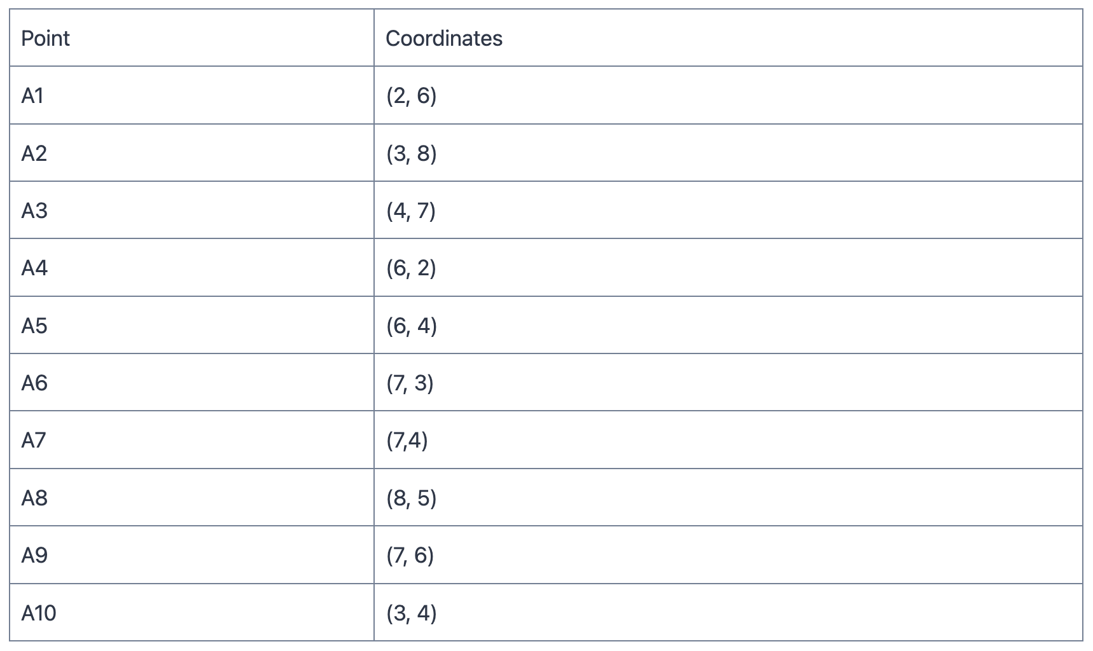
K-Medoids Numerical

Slide 119
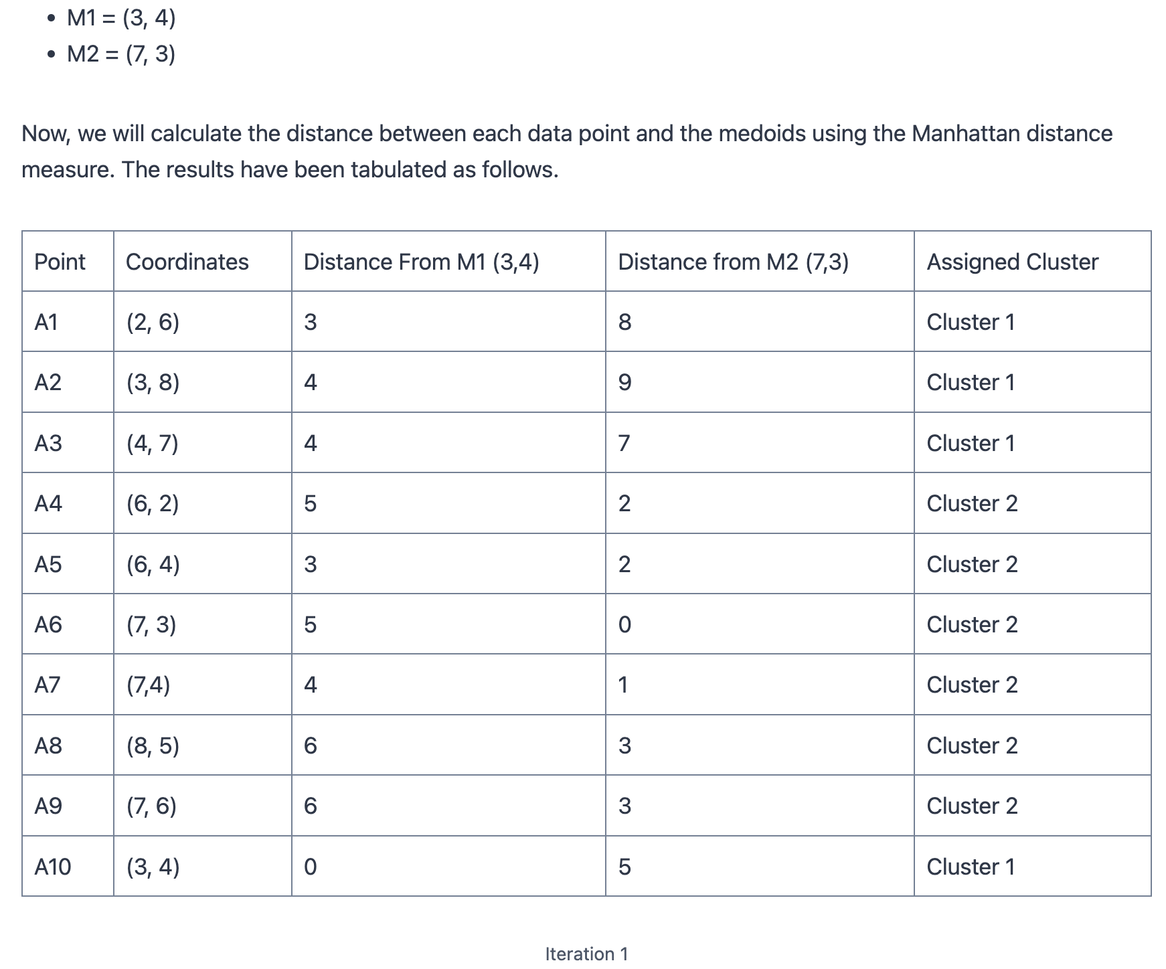

Slide 120
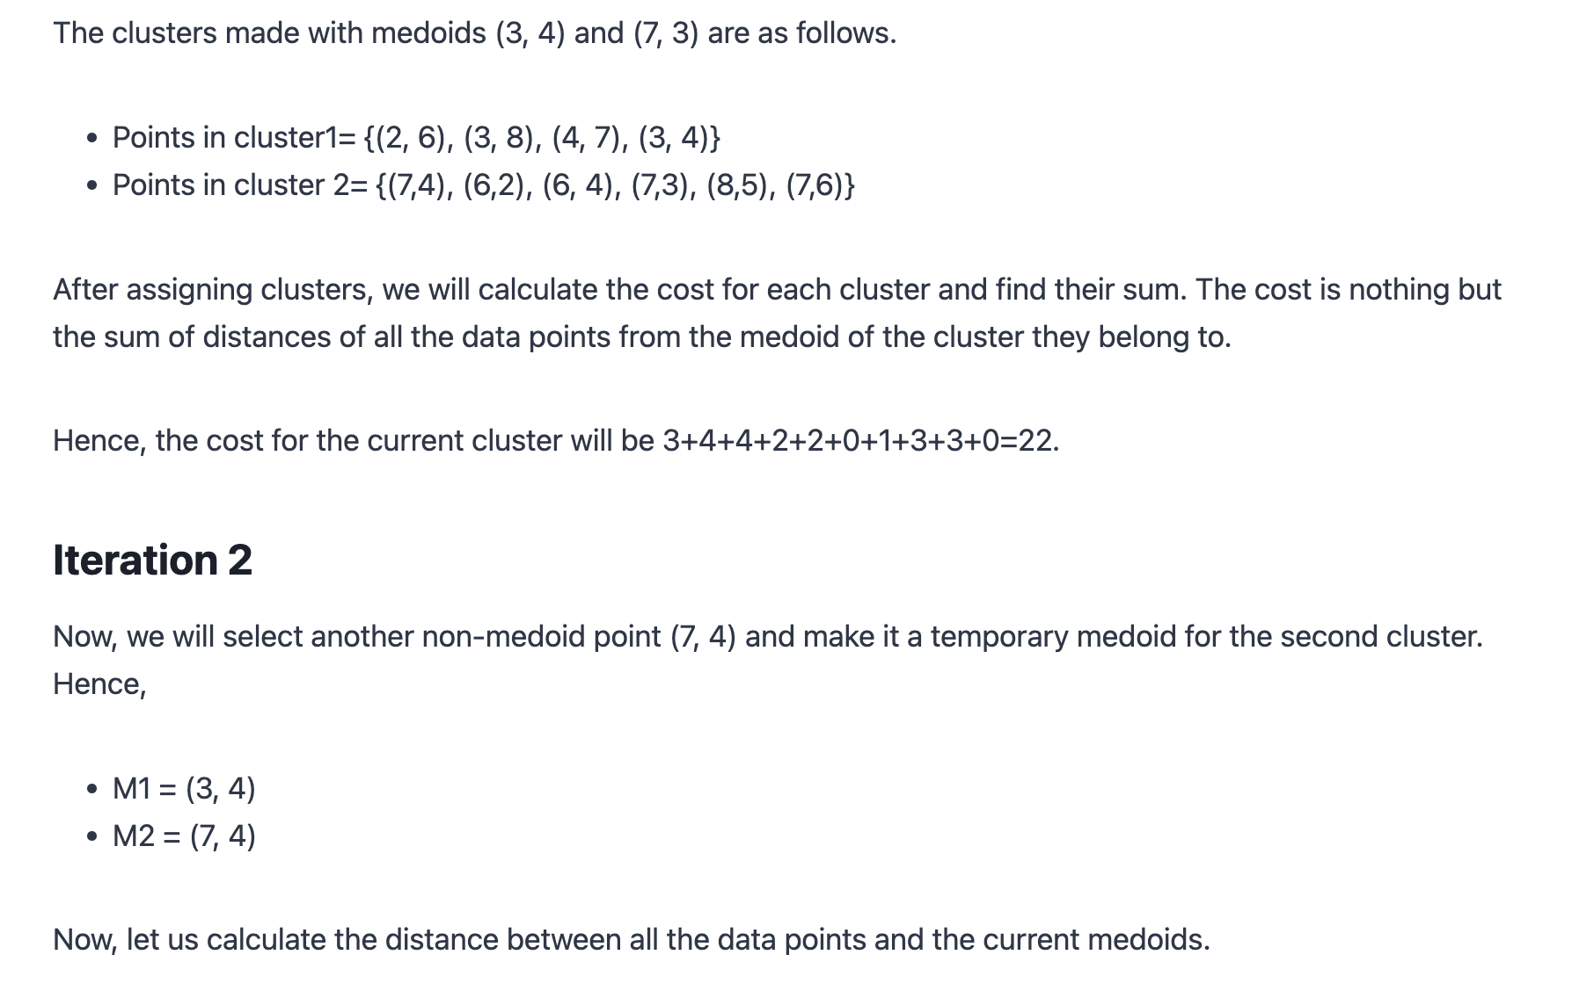

Slide 121
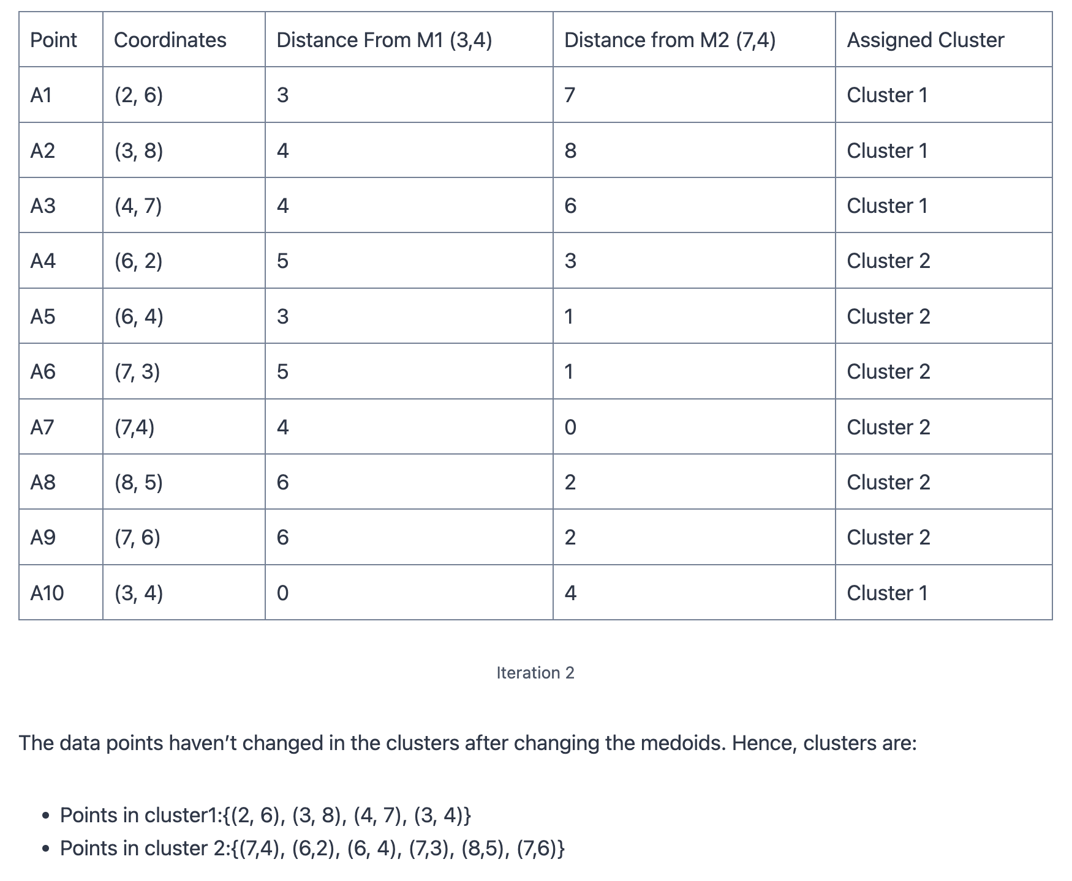

Slide 122
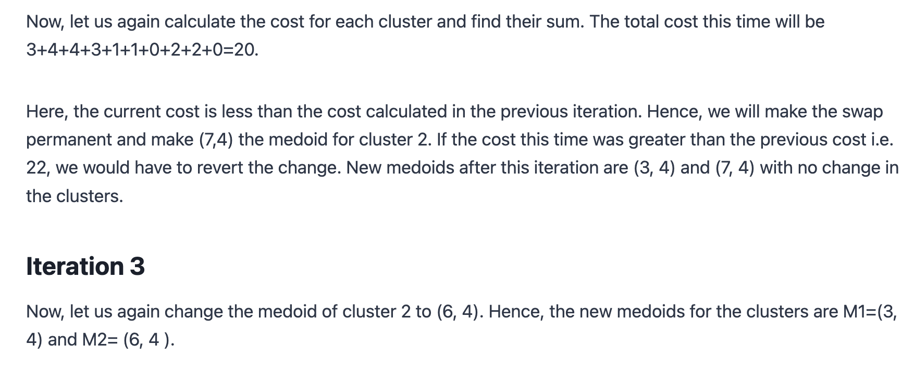

Slide 123
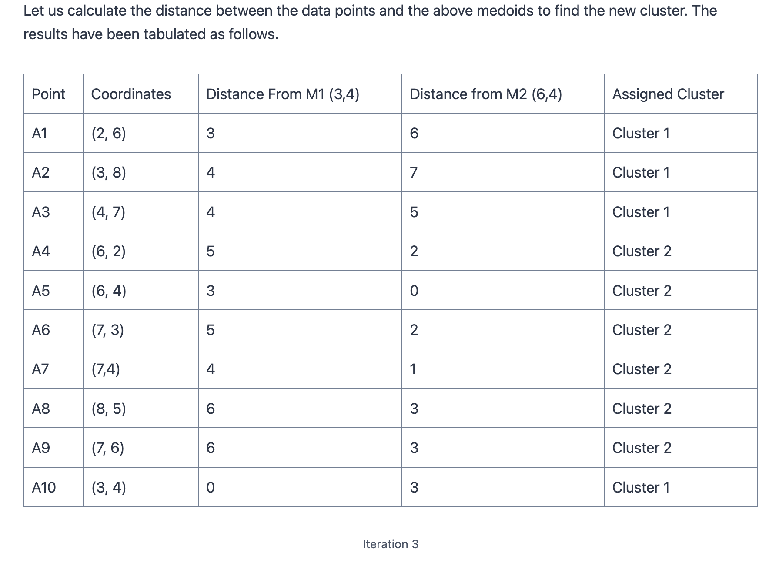

Slide 124
